Slide 2

Pool Training

Slide 3
01
Introduction
Pool, water and parameters

Slide 4
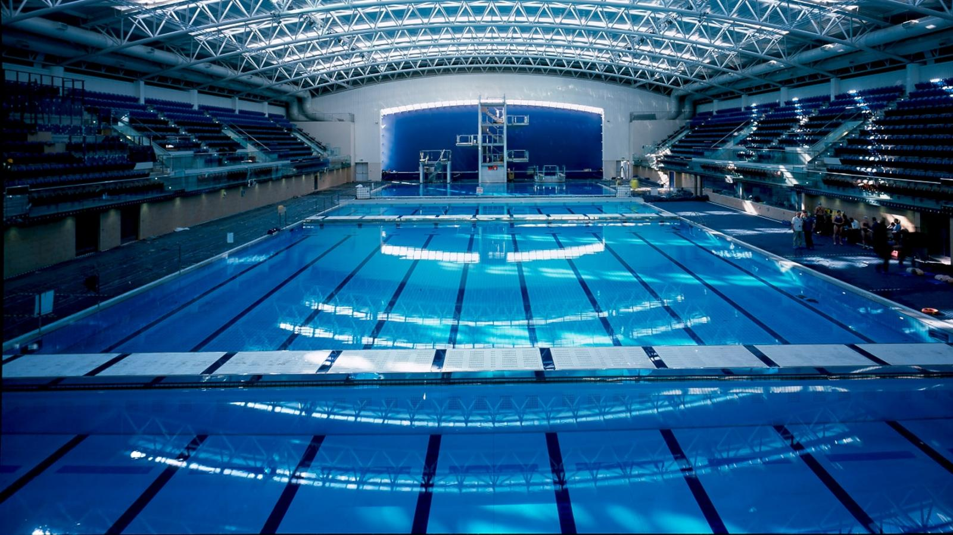
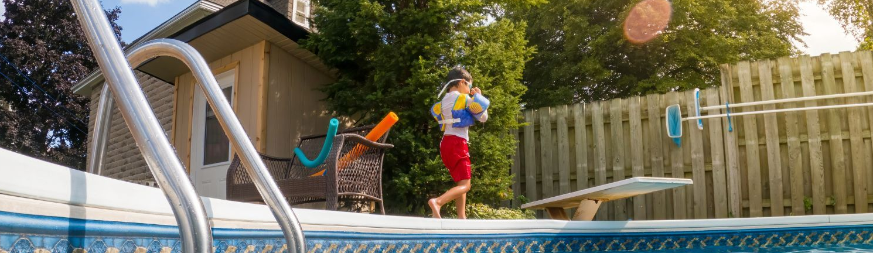

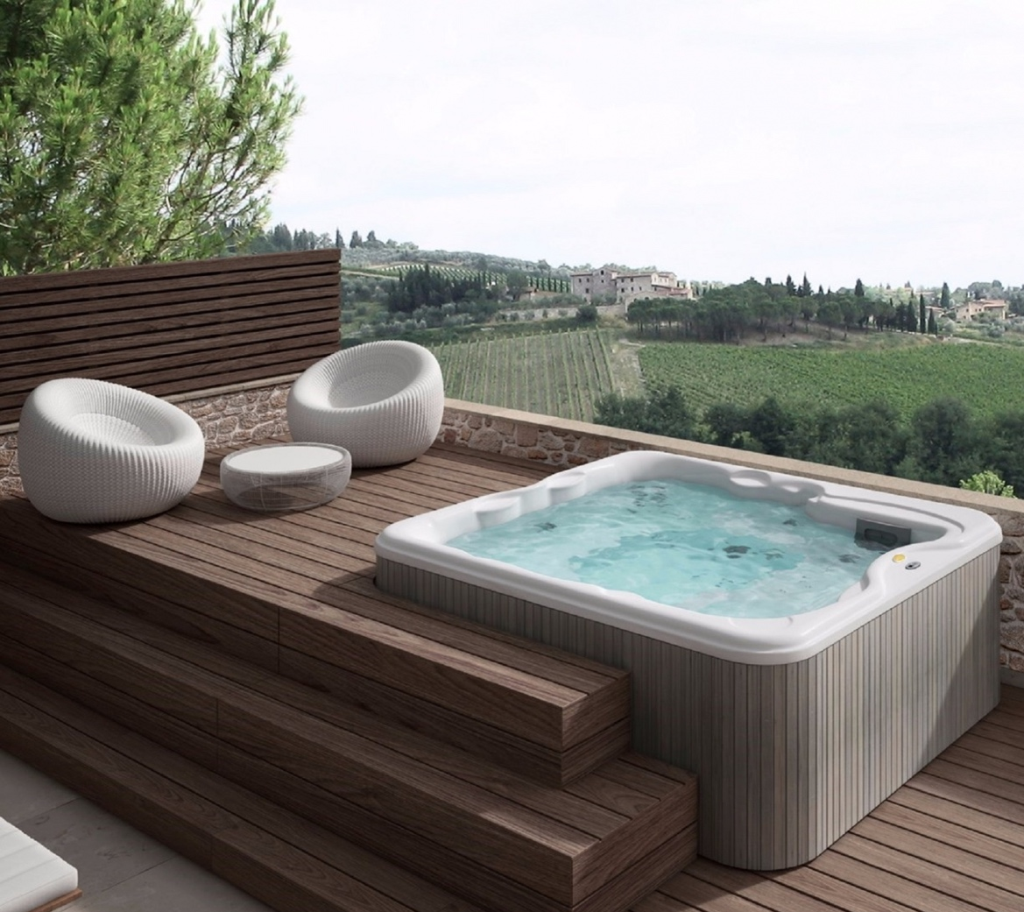

A swimming pool is a private or public structure designed to hold water to enable swimming or other leisure activities.
We can split pools in different category considering:
  Building structure: in or above the ground, tube spa, infinity, zero-entry or suspended pool
  Material: concrete, natural stone, metal, plastic, composite or fiberglass
  Temperature of the water: hot or cold
  Indoor or outdoor
We can manage all the different kinds of pool in the same way: some features will change but our target will be exactly the same

Slide 5

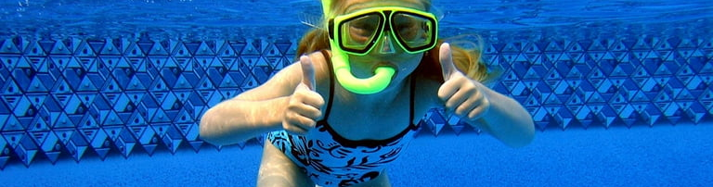
Water is alive and its parameters are constantly changing. This is why we must continuously intervene to ensure stable disinfection

Slide 6

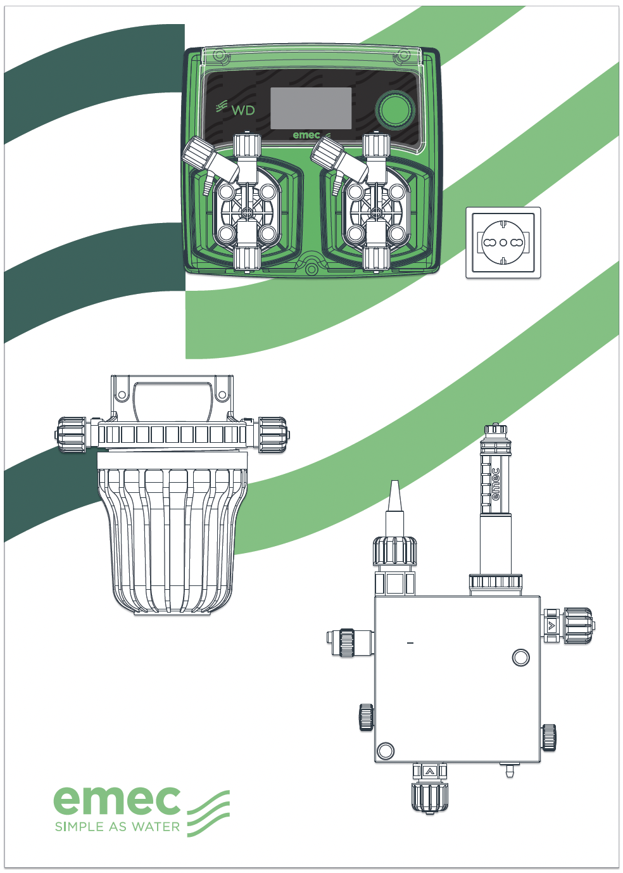



Automatic control
Why should I buy an automatic control system?
“To dose chemicals in the correct quantity and especially when needed”

Slide 7



Automatic control
So that pools remain places of .. “Well-being”

Slide 8
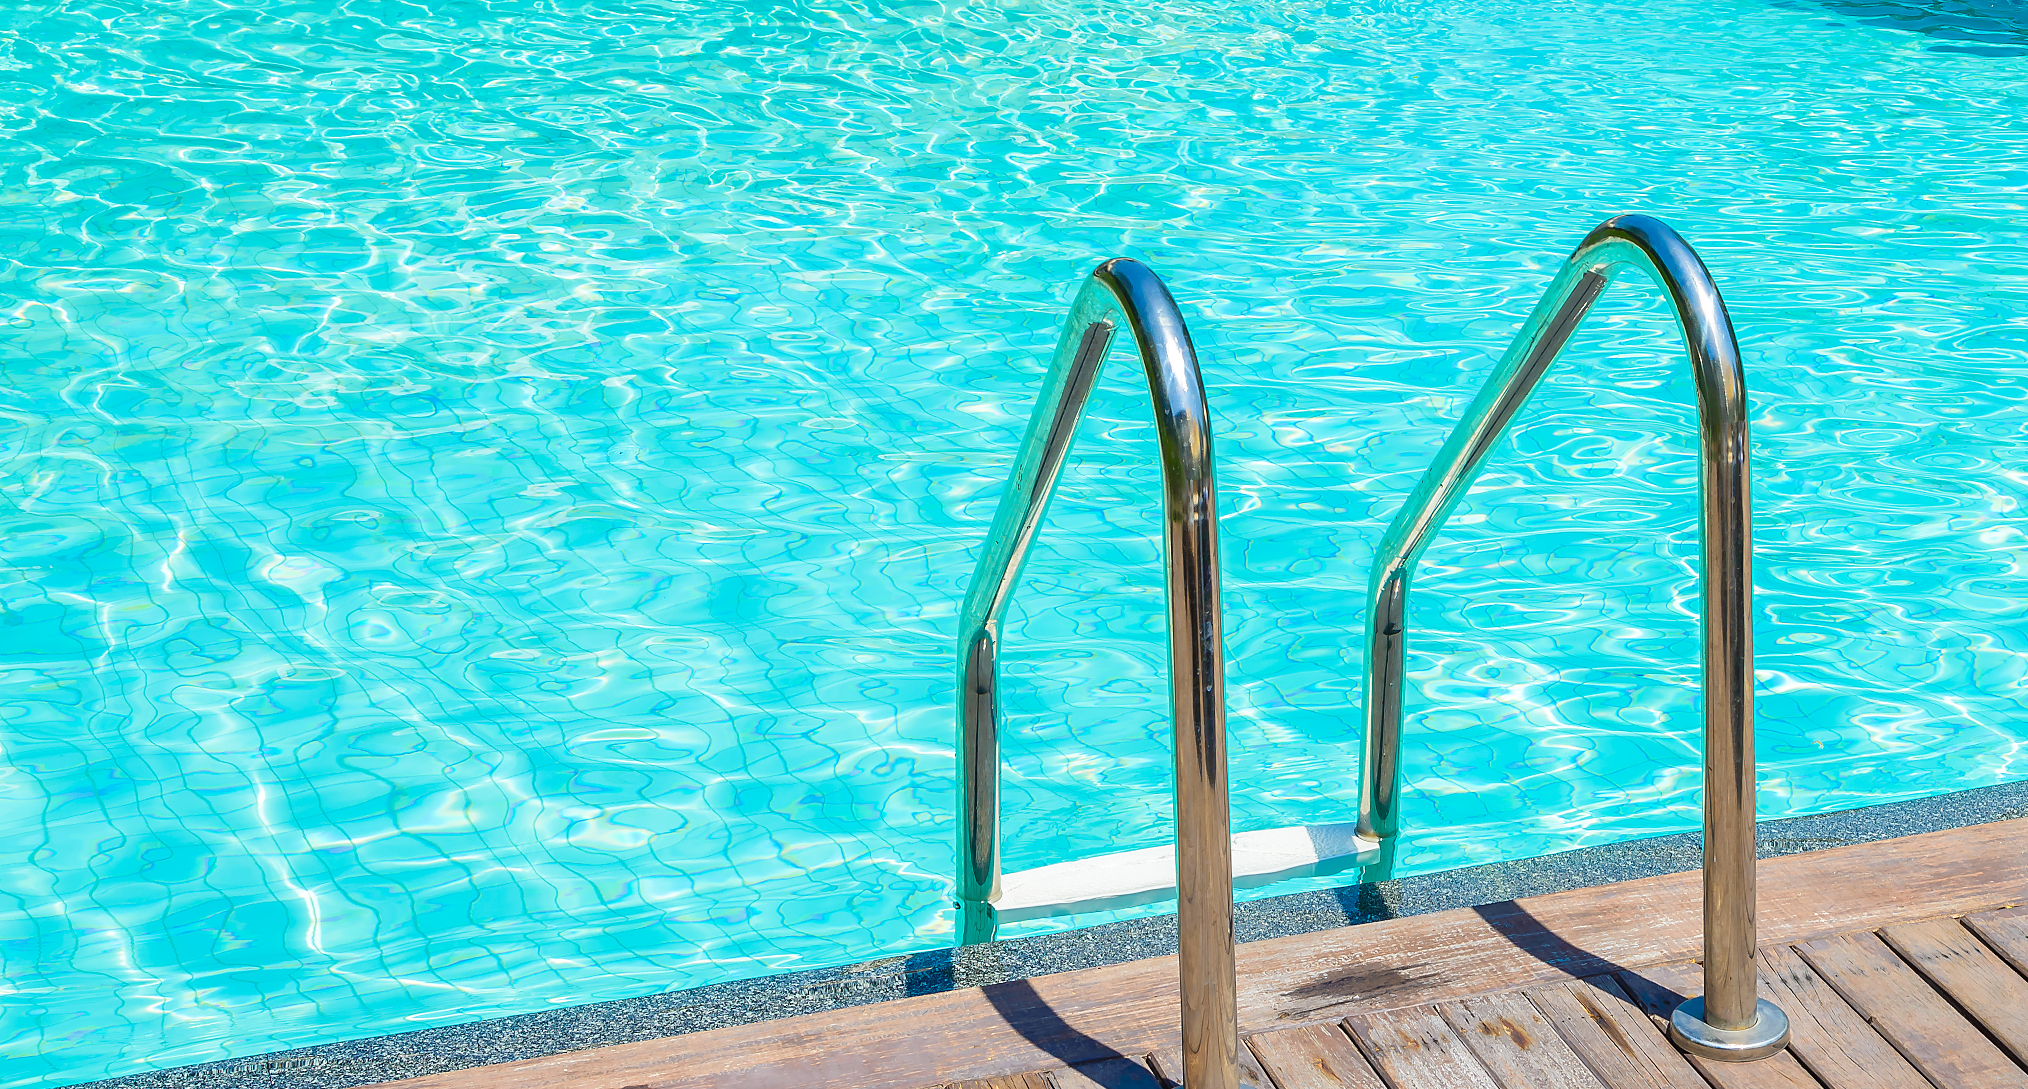
Automatic control
The correct dosing of chemicals is necessary

Slide 9
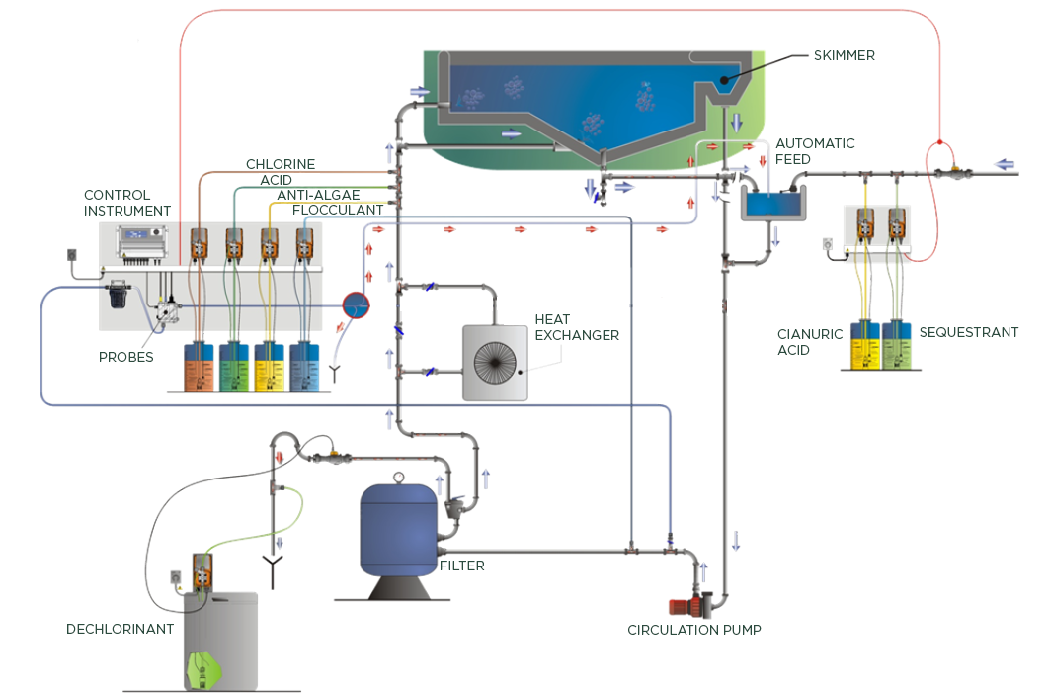
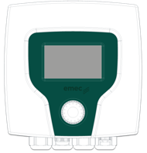
Public swimming pool installation

Slide 10
02
Swimming Pool Water
Parameters and measurements

Slide 11

Dosing and controlling parameters
in the swimming pool
  pH
  Disinfection level (ORP)
  Disinfectant (Chlorine)
  Turbidity
  Flocculant
  Antialgae

Slide 12
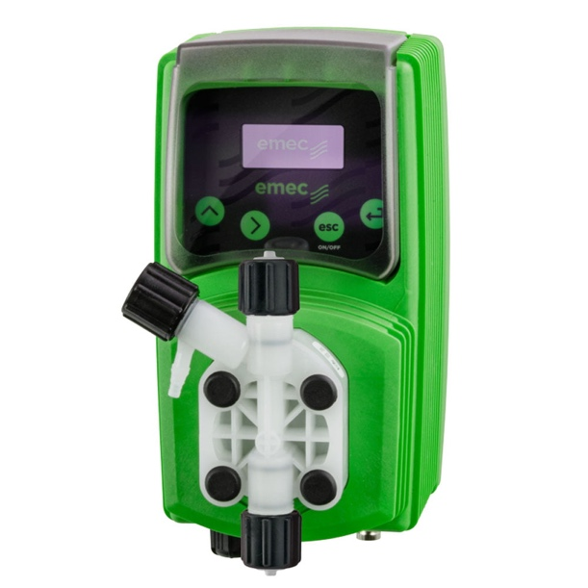
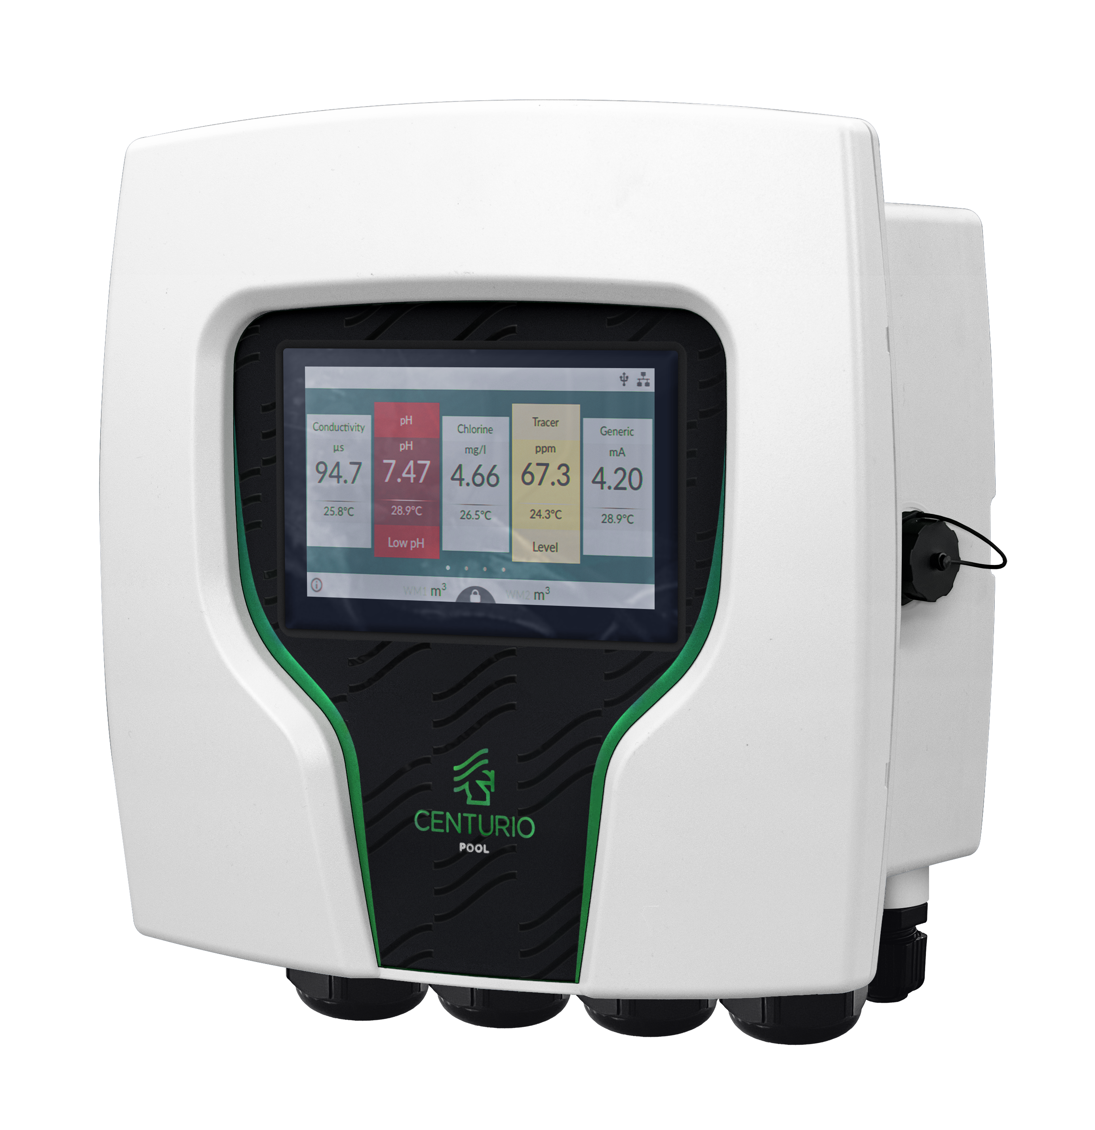
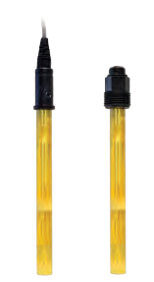
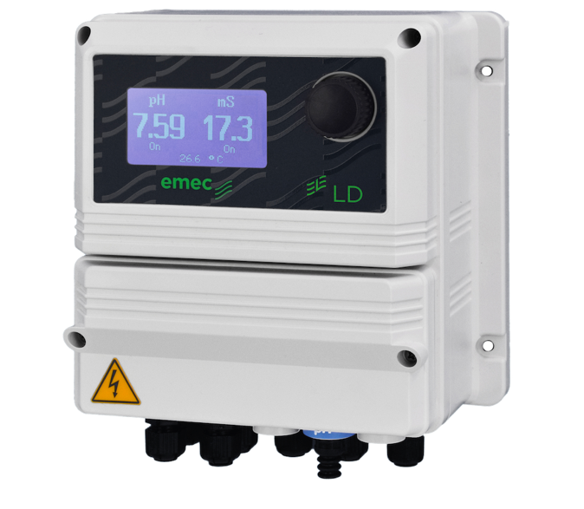

pH
pH (potential of Hydrogen) is a number between 0 and 14 that expresses the concentration of hydrogen ions (H+) dissolved in water (H₂O). pH below 7 indicates acidity, above 7 Alkalinity, while pH=7 is neutral level
Dosing of pH corrector (acid/base) to reach optimal setting
pH electrode
ATTENTION! Managing pH is extremely important, since an outbalanced level
of pH can determine a failure in the disinfectant action of the disinfectant dosed.

Slide 13
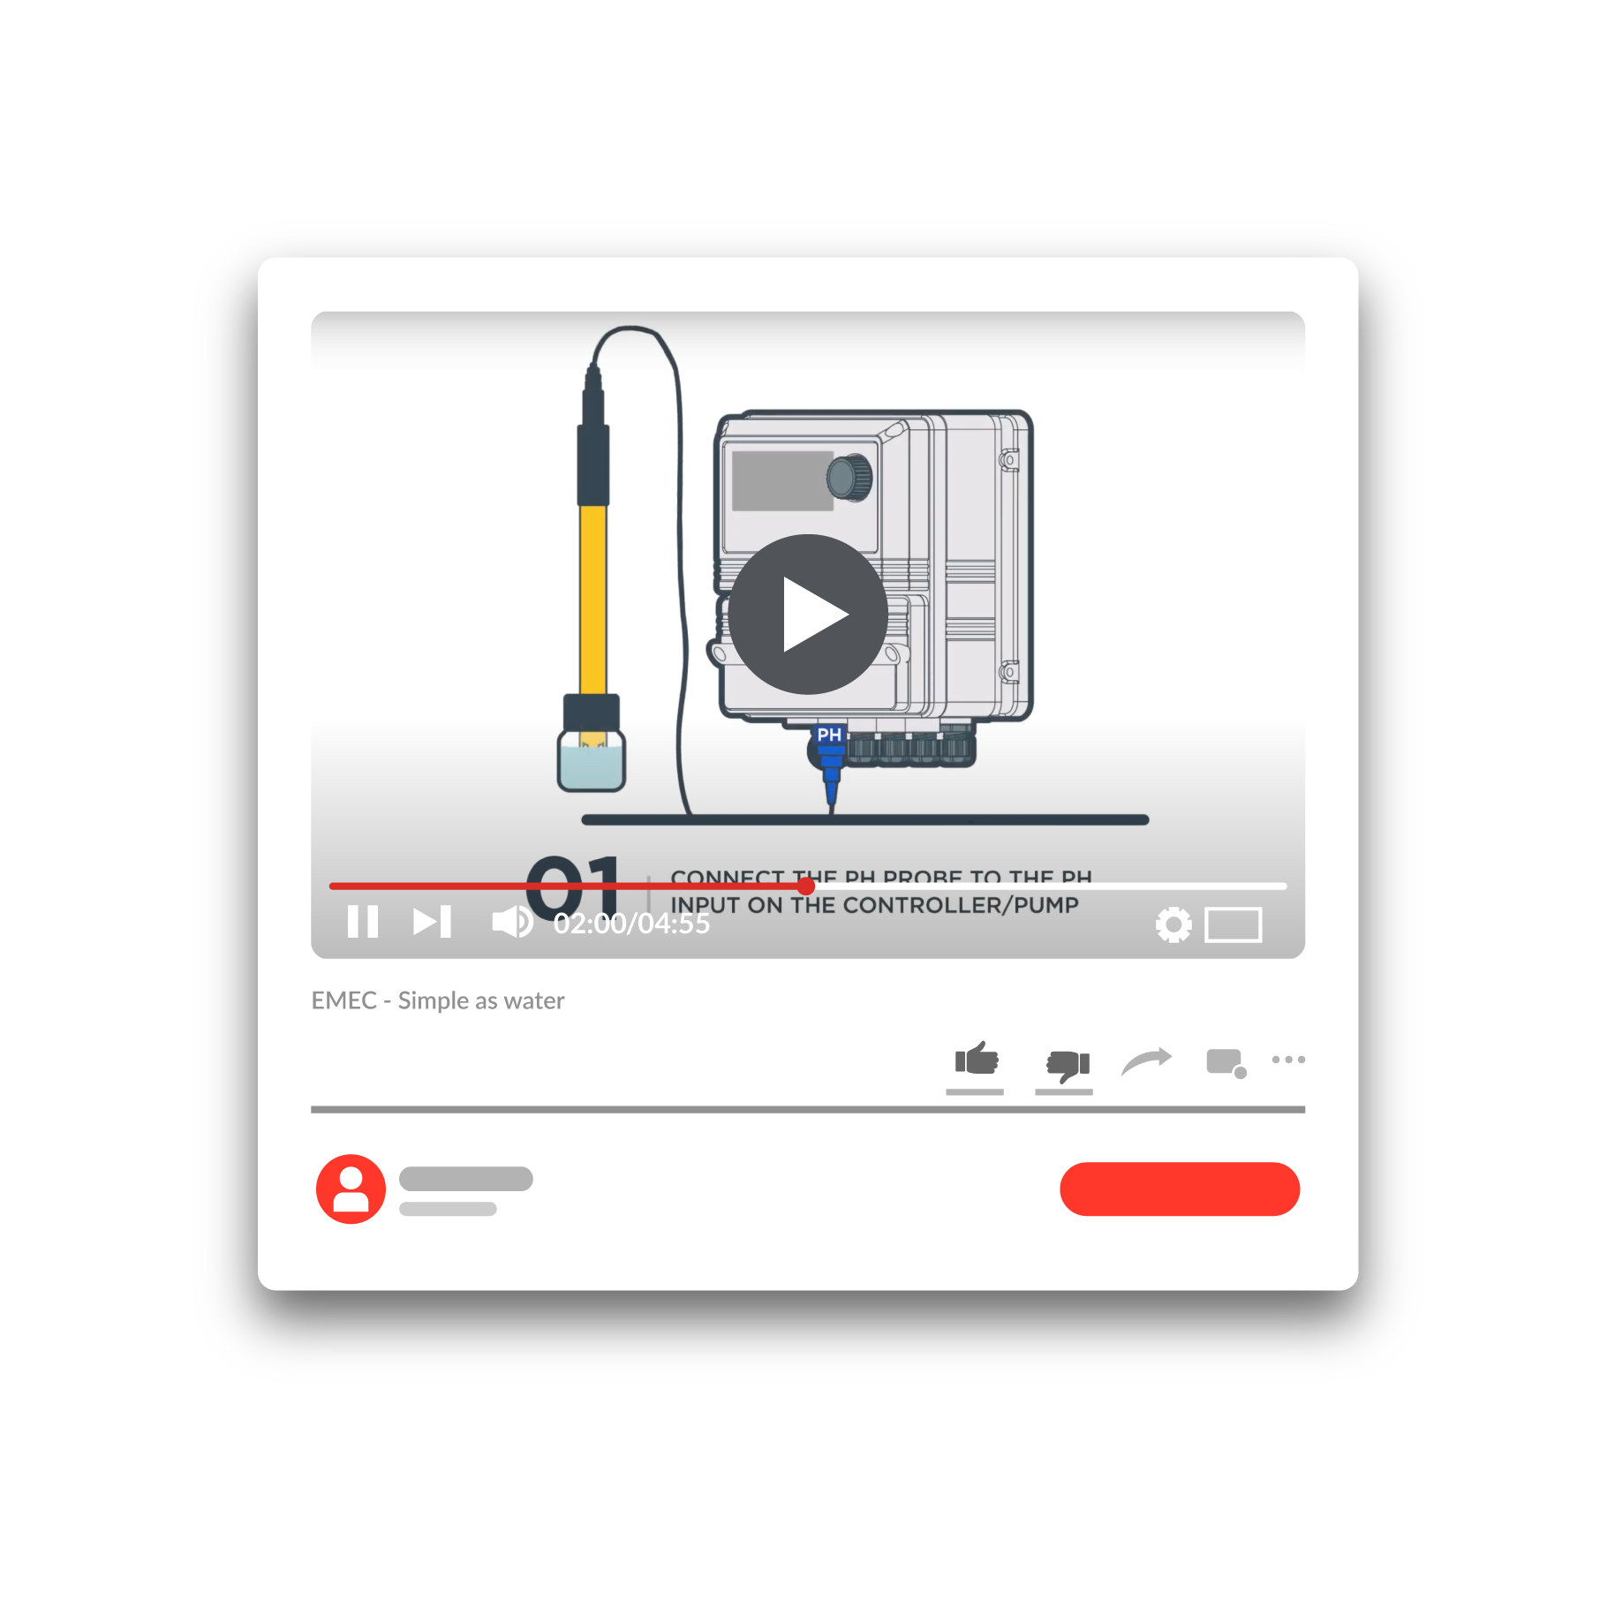

pH
pH Probe Video Tutorial:
Inserting the electrodes
in the probe holder:

Slide 14
Redox Potential ORP
Redox is a type of chemical reaction in which the oxidation states of a reactant change. Oxidation is the loss of electrons or an increase in the oxidation state, while reduction is the gain of electrons or a decrease in the oxidation state.
The name comes from the combination of two terms: reduction (red) and oxidation (ox) oxidation: subtraction of electrons, reduction: acquisition of electrons “Oxidising capacity of water”: value expressed in mV
Dosing of disinfectant to increase the disinfecting level
ORP electrode
ATTENTION! If he following increase (pH/ Isocyanuric acid/ Degree of contamination)
Redox value decreases

Slide 15
Redox Potential ORP
Redox ORP Probe Video Tutorial:
Inserting the electrodes
in the probe holder:

Slide 16
Disinfectants: Chlorine
(Organic/Inorganic)
Sodium Hypochlorite (often referred to as just Chlorine) is one of the most common disinfectants used for swimming pool water treatment. It is mostly used (depending on the requirements) in two forms, organic and inorganic chlorines. These represent stabilized and non-stabilized chlorine respectively. The difference between these two types of chlorine in it is the presence of isocyanuric acid.
Dosing of Sodium Hypochlorite to increase the disinfecting level
Sensors for Organic and Inorganic chlorine

Slide 17
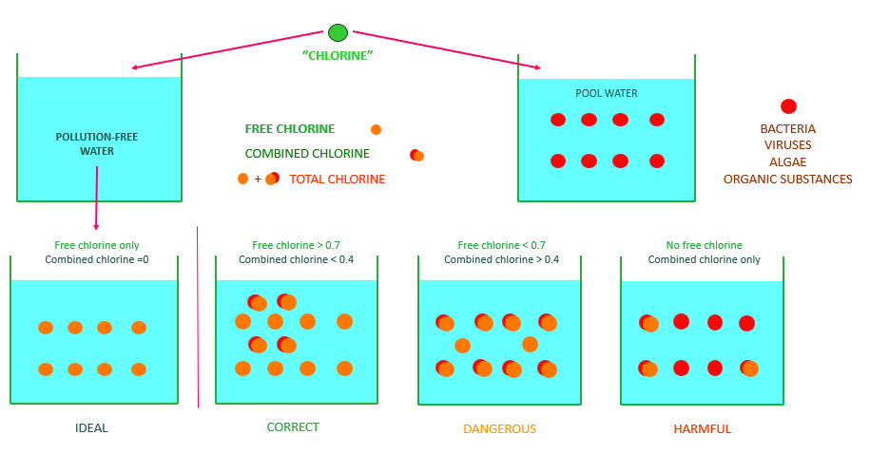
Disinfectants: Chlorine
(Free/Total/Combined)
Once Chlorine releases its disinfecting action and attacks harmful bodies in the pool, it becomes «inactive», and in some cases it can also become unpleasant to the water quality. Thus it is necessary to measure the levels of Free Chloring (ready to disinfect), combined chlorine (used Chlorine) and Total Chlorine (Free Chlorine + Combined Chlorine).
EMEC offers sensors for Total and Free Chlorine, while our controllers calculate the Combined Chlorine level from these two

Slide 18

Disinfectants: Chlorine
Influence of pH on hypochlorous acid: “Hypochlorous acid splitting curve”
Water + chlorine
HClO
Hypochlorous acid
Hypochlorous acid as a function of pH
HClO = H+ + ClO-
HClO 100 TIMES faster than CLO- (Hypochlorite Ion)

Slide 19
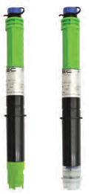
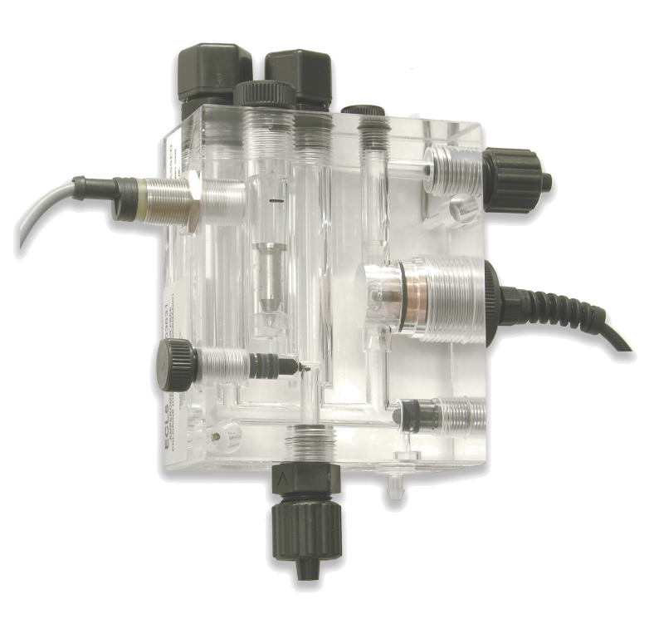
Disinfectants: Chlorine (EMEC solutions)
EMEC offers different solutions for different needs.
Closed amperometric cells
Open amperometric cells
Options:
Free Chlorine
Total Chlorine
Organic Chlorine
Inorganic Chlorine
Advantages:
Cut edge Precision measurement
Possibility to calculate Combined Chlorine
Options:
Free Chlorine
Organic Chlorine
Inorganic Chlorine
Salt-water option
Advantages:
Resistance to challenging water conditions
Embedded self-clean system

Slide 20
Disinfectants: other desinfectants
EMEC offers solutions also to read other used disinfectants and other chemicals
Bromine
Hydrogen peroxide
Peracetic acid
Chlorites
Chlorine dioxide

Slide 21
Redox Potential ORP
Preparation SCL3S:
Preparation SCL3N:
Calibration SCL3S:
Calibration SCL3N:
Resting SCL3S:
Resting SCL3S:

Slide 22

Turbidity
The measurement of Turbidity identifies the amount of particles present in the water.
Dosing of Flocculant (combined with Filtration) can reduce significantly the levels of Turbidity
Optical Turbidity sensor
ATTENTION! High Turbidity affects not only the aestethics of the swimming pool, but also represents a risk for disinfection since every particule in the water can bare bacteria.

Slide 23
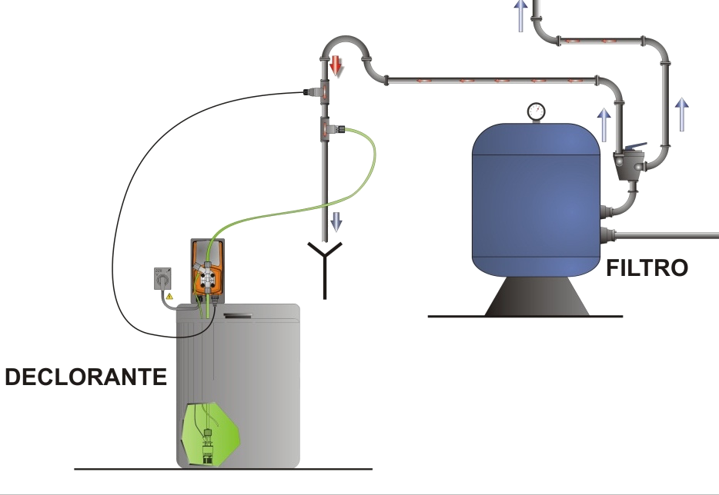
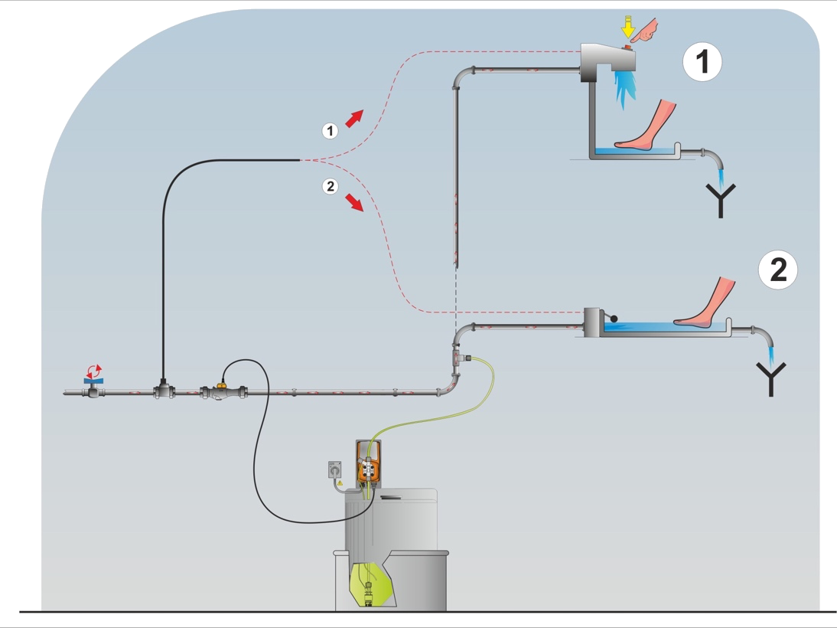
Other insights
The measurement of Turbidity identifies the amount of particles present in the water.
Anti-algae
Dechloration
Shoch-treatment dosing of Anti-Algae (with a timer-controlled pump) counters the presence of floating micro flora or flora adhering to the walls of the pool (algae)
Dosing a Dechlorant in the wastewater that comes out of the filter is critical for the environment and a legal requirement in most countries!
Foot-bath disinfection
Dosing of antimycotic in the foot-bath is critical to prevent contamination of the swimming pool and keep the water safe to all users!

Slide 24
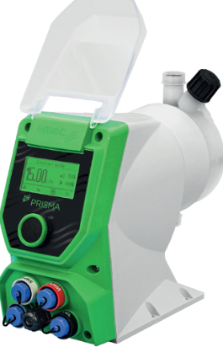
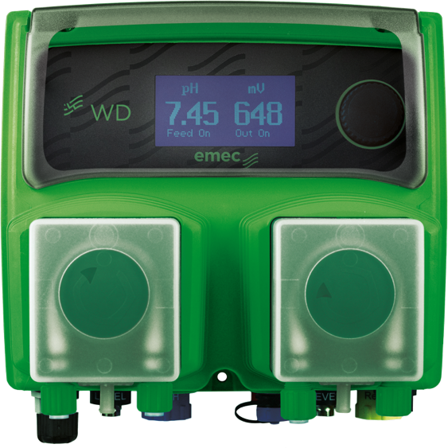

Dosing
EMEC offers different solutions to dosage, both in capacities (from 1 to 100 l/h) and in technology (Solenoid/peristaltic/stepper motor).
Unboxing-installation venting
tube-installation delivery hose:

Slide 25
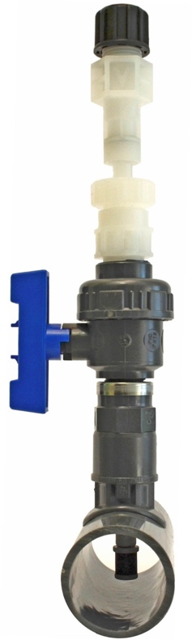
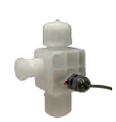
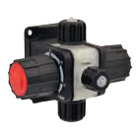
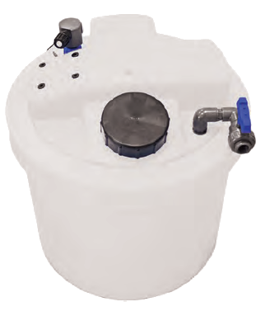
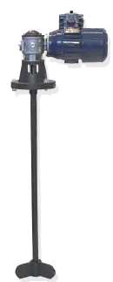
Accessories
EMEC offers a wide range of accessories to provide the most complete solution in Swimming Pool water management
LINI
Injection lances
MFKT Multifunction valves
SEFL Flow sensor
…and more!
To optimize dosing in the tubes
To secure chemical from pressure instability
To guarantee each stroke in dosing

Slide 26
03
Emec Solution
EMEC provides a wide range of complete solutions Plug&Play, from the most basic to the most complete to cover all of the needs of the market!
Here are some of the most common – remember that our strenght is flexibility and taylor made solutions, so don’t hesitate to ask us for more particular ones!

Slide 27
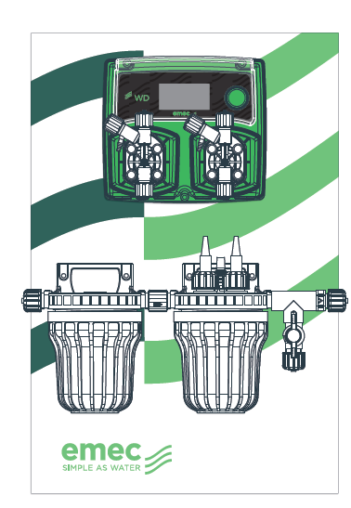
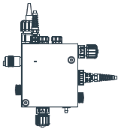
Complete solutions
All-in one Double Dosing controlling system
1 pump pH corrector
1 pump disinfectant
Filter
Probe holder with Flow sensor
1 probe pH
1 probe Redox/Chlorine (*)
(*) Chlorine probe option

Slide 28
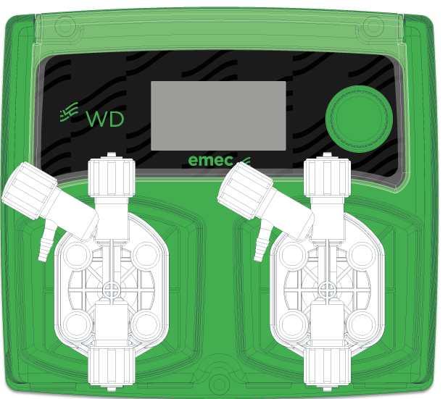
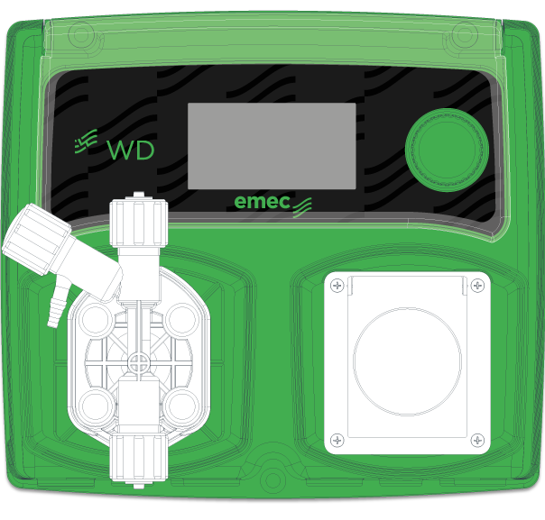
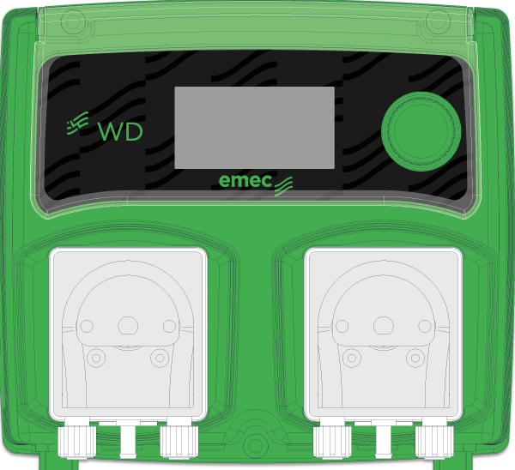
Double dosing controllers
Two channel reading
Double dosing
pH priority dosing
Flow control
Dosing alarm
Probe failure alarm
Double dosing
controller
Controller with 1 pump + 1 plug for external Chlorine generator
Peristaltic pump option

Slide 29
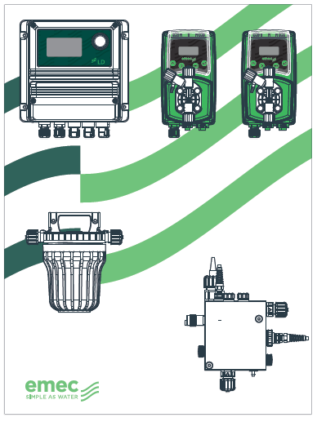
Complete solutions
LD double-parameter controller
Dosing pumps
pH corrector
disinfectant
Filter
Probe holder with Flow sensor
1 probe pH
1 probe Redox/Chlorine

Slide 30
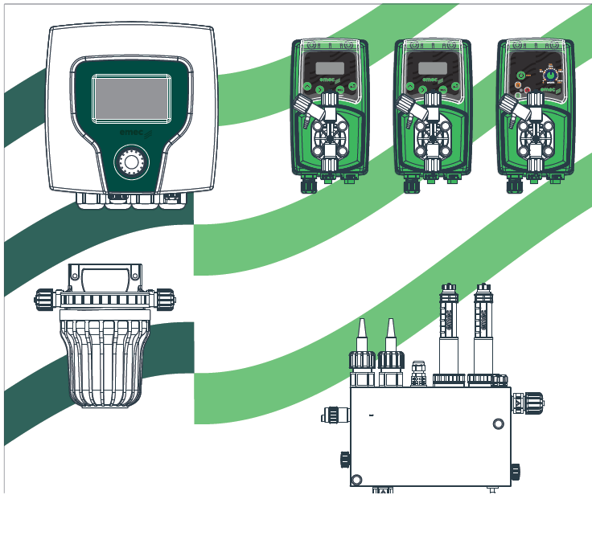
Complete solutions
CENTURIO Multiparameter swimming pool controller
Dosing pumps:
pH corrector
Chlorine
Flocculant
Filter
Probe holder
with Flow sensor
1 probe pH
1 probe Redox
1 Amperometric cell – Total Chlorine
1 Amperometric cell – Free Chlorine
(Combined Chlorine calculated by controller)

Slide 31
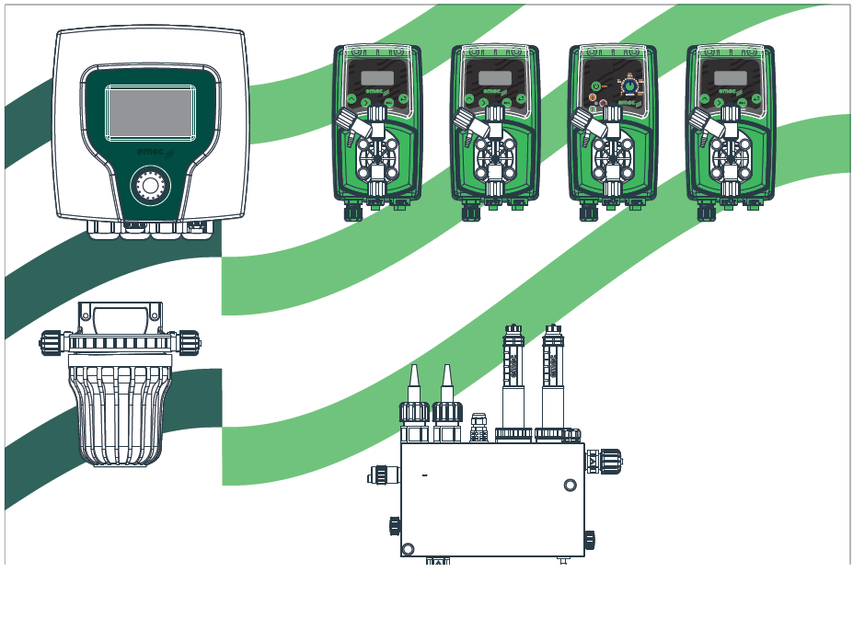
Complete solutions
CENTURIO Multiparameter swimming pool controller
Dosing pumps:
pH corrector
Chlorine
Flocculant
Anti-algae
Filter
Probe holder
with Flow sensor
1 probe pH
1 probe Redox
1 Amperometric cell – Total Chlorine
1 Amperometric cell – Free Chlorine
(Combined Chlorine calculated by controller)
Turbidity sensor

Slide 32
CENTURIO POOL
Up to 10 channels
Modular channel setting
Embedded Ethernet-USB-Modbus communication
6 timers to control lights, shock chlorinations, electrical timerized pool features
Temperature probe reading for pool water temperature regulation
Flocculant dosing control
Dechloration Purge control

Slide 33
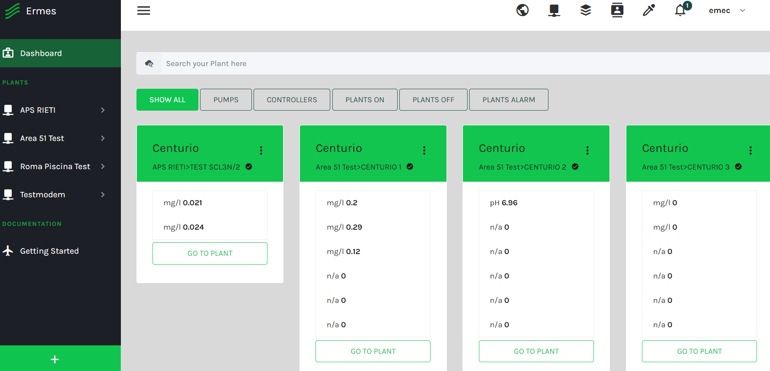
COMMUNICATION
Connect your system to the web to control it always from your PC

